Slide 1
Metrics 101
Produced by the TMF Reference Model Metrics and Reporting Sub-team
1 August 2014

Slide 2
Agenda
Why a metrics program?
Goals of a metrics program
Types of metrics
Further analytics on metrics
Metrics program design
Metrics program implementation
Final thoughts
Notes:
Note that this presentation is the output of the Metrics and Reporting sub-group that met over the course of 2013 to define recommendations around TMF/eTMF metrics and reports

Slide 3

Why a Metrics Program?
“Measurement is the first step that leads to
control and eventually to improvement. If you can’t measure something, you can’t understand it. If you can’t understand it, you can’t control it. If you can’t control it, you can’t improve it.”
― H. James Harrington

Slide 4
Perspective: Performance Measurements and Continuous Improvement
A formal Performance Metrics Program brings value because it…..
Provides a clear link and focus to strategy and strategy realization
Creates alignment, transparency, and accountability at all levels in the organization
Enables a focus on continuous improvement efforts where they have the most impact
Enables fact based decisions – not “gut feel” - You can’t improve what you don’t measure
Creates a common language to assess and improve performance
Industry Status: Demonstrating Value with Performance Metrics and Continuous Improvement
DIA EDM San Diego: Fall 2013
Steve Gens, Managing Partner, Gens and Associates, Inc.

Slide 5
Goals of a Metrics Program

Slide 6
Goals of a Metrics Program
Provide insight into the ongoing status and quality of a trial
Provide insight into overall trends to support process improvements
Allow a CRO to report statistics to their sponsor
Allow the comparison of a sponsor's CROs against their Service Level Agreements
Support planning for future studies (headcount, timeframes...)
Allow a sponsor or CRO to monitor performance of specific departments or groups
Allow a sponsor or CRO to monitor performance against the industry as a whole
Allow the comparison of a sponsor's CROs against each other
-- according to a recent informal survey
Notes:
Prioritized – high level goals. Individual metrics also have their goals/business drivers

Slide 7
Types of Metrics

Slide 8
Types of TMF Metrics
Type | Definition
Administration | Indication of whether TMFs have defined ownership and planning measures in place
Completeness | Extent to which a TMF/eTMF contains all documents that are expected at the current point in the study (usually based on last milestone date), or, for completed trials, at the end of the trial.
Quality | Measure of whether document content, metadata, and indexing are complete and accurate
Timeliness | Indication of whether documents are available when expected or needed, and of how long documents take to finalize
Use | Measure of how frequently an electronic TMF system is accessed
Volume | Measures of the types, numbers and sizes of documents in a TMF/eTMF
Notes:
The working groups’ defined sets of metrics all fall within one of these categories, in some cases within sub-categories

Slide 9
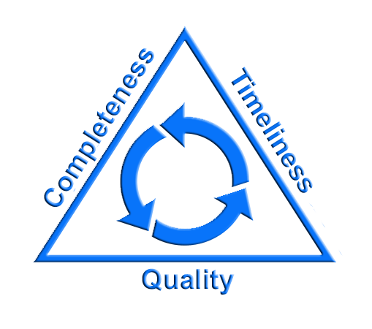
TMF Key Parameters for Metrics
Completeness: so that the authorities can reconstruct the trial and ensure GCP compliance
Timeliness: so that accurate decisions can be made based on close to real-time information
Quality: so all parties can have confidence in the documented processes and data
Notes:
Quality by Design development of CTQs (Critical to Quality) measurements led to identification of 3 measures critical to ensure quality in TMF
Reference Pfizer Paper, confirmation by working group

Slide 10
Completeness: Challenges
“Procedures should be in place … to assure that the TMF is complete and accurate.” - EMA Reflection paper on GCP compliance in relation to trial master files (paper and/or electronic) for management, audit and inspection of clinical trials
But… how do you measure completeness?
  To know what’s missing, you must know what is expected
  Different for every trial
  Changes of the course of the trial
  For paper TMFs, tracked in a highly manual way
Notes:
Differences in every trial based on the type of trial, the countries in which it is conducted, the characteristics (blinded, technologies uses such as IVRS or EDC, etc.)
Changes as the protocol is amended, unplanned events occur, or the requirements of sponsors or regulatory authorities change
Trending in paper TMFs is difficult if not impossible

Slide 11
TMF Completeness – what do you measure?
  TMF Completeness assesses if all anticipated documents are collected for trial.
    Comparison of anticipated content index to filed content
    Manual process for paper trials
  eTMF facilitates completeness metrics
  Visual signals for audit / inspection readiness
  Take action before milestones are missed
  Real time course corrections and identification of trends
TMFs completeness can also be measured across programs – are all TMFs accounted for and well controlled throughout their lifecycle?

Slide 12

Timeliness – What are You Measuring?
“The TMF should to be up to date, with documents placed in the TMF in a timely manner with the aim to maintain the TMF “inspection ready”.” – EMA Reflection paper
How do you know when documents are due?
  Most documents can be tied to a milestone
  Best case: monitor documents against due dates
  Next best: monitor to ensure documents tied to milestone are received by milestone due dates
  Better than nothing: all received before TMF can be closed out and archived
Notes:
For event based documents such as protocol amendments, due dates are more challenging
May want to define a lag such that documents are due in TMF/eTMF by x days after the milestone date

Slide 13
Timeliness – What Do You Measure?
Compliance with protocol and study timeline
  Is content created, finalized and filed in alignment with timeline and study processes?
Timely availability of documents
  Is a document collected and filed/uploaded in a timely manner so that it can be generally available by its due date?
Effectiveness of processes
  Is a document quality checked and finalized in a timely manner after receipt?
  Do bottlenecks inhibit timely process flow?
Notes:
It’s not just as simple as whether the document is received by its due date – the underlying processes both outside of and in the eTMF must be understood.
In other words, if documents are late, is it because they were not created or received in time, or because it took too long to perform QC and finalize them in the eTMF?

Slide 14
Quality: What Can Go Wrong?
“Failure to fully document and perform effective QC checks on documents uploaded into eTMF – the result being that the inspectors had no confidence that the eTMF was accurate. Discrepancies were seen, as were missing pages, incorrect documents, poor quality scans.”
- reported in EMA Reflection paper
“… recommendation that there are regular reviews is to ensure that the documents remain accessible, readable, are filed/named appropriately, so that if there are any issues with the process, individuals utilising the system or the functioning of the system itself, they may be detected and managed. We have seen issues on inspection where scanned documents have not been readable, or not been complete.”
- Clarification provided in email by MHRA

Slide 15
TMF Quality Measurements
Accuracy and completeness of documents
  Missing signatures, inaccurate dates, incorrect annotations
Accuracy of file location / eTMF indexing
  Document filed in the correct location
  Accuracy of metadata for eTMF – assigned to correct trial, site, doc type, etc.
For scanned content, accuracy and completeness of visual image
  Defects such as missing/extra pages, skewing, etc. must be detected

Slide 16
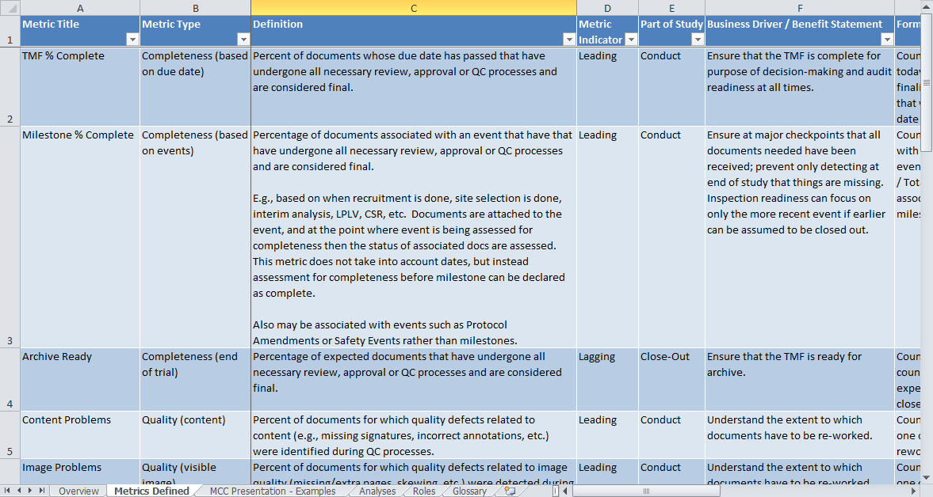
TMF Metrics
The Metrics Working Group has defined a total of 21 metrics for consideration
Notes:
This does not mean that we recommend that every organization track all 21 metrics. Later in the presentation, we will discuss selection of metrics to support business objectives and quality by design

Slide 17
Metrics Definitions
Each metric is defined with details to aid in understanding its business value, how it should be computed, etc.
Standard metrics structures defined by the Metrics Champion Consortium were taken into consideration and augmented with TMF specific information
Notes:
Founded in 2006, MCC is the leading industry association dedicated to the development of standardized performance metrics to improve clinical trials. MCC provides the collaborative environment for biopharmaceutical and device sponsors, service providers and sites to improve clinical trial development through use of MCC standardized performance metrics. The MCC’s performance metrics portfolio includes central lab, imaging, cardiopulmonary assessment and clinical trial metrics. Over 100 companies have joined the MCC.

Slide 18
Defining Metrics (1 of 2)
Metric Title
Metric Type (completeness, quality, etc.)
Definition
Metric Indicator
  Leading: shows opportunity for change within a current trial based on that reported metric. They are predictive and can provide forward-looking glimpses into the progression of a trial
  Lagging: shows opportunity for change in a future trial based on results of previous trials. They are statements of what has already occurred, and are best looked at to evaluate performance for future trials. They are results instead of a prediction.

Slide 19
Defining Metrics (2 of 2)
Part of Study (Start Up, Conduct, Close-Out)
Business Driver / Benefit Statement
Formula / Example
Reporting Frequency: recommendation on how often metric should be measured and reported
Notes on eTMF vs. Paper
General Notes

Slide 20
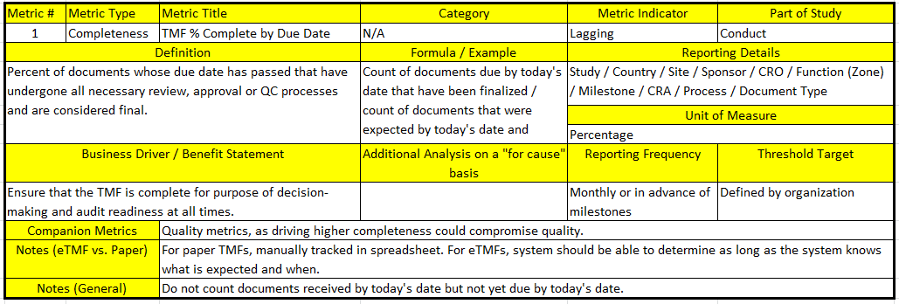
Metrics Example: Completeness by Due Date

Slide 21
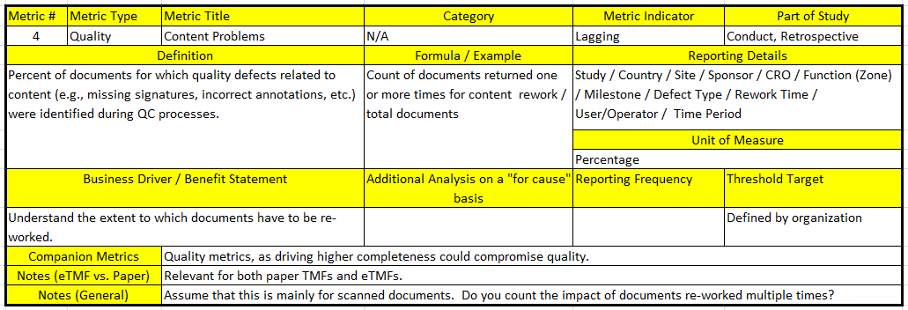
Metrics Example: Quality: Content Problems

Slide 22
Paper TMF vs. eTMF Metrics
eTMF data enables speed and ease with metrics
Issues in paper TMF metrics
  Some metrics do not apply (scanning quality)
  Many may be labor-intensive
For paper TMF, consider a risk-based approach to make metrics practical and cost-effective
  Focus on a subset: high risk content, critical trial process, critical path trial, new personnel, signals from audits

Slide 23
Further Analysis On Metrics

Slide 24
Further Analysis on Metrics
Insight requires relevant information that reveals actionable details about a process
For metrics to be meaningful and actionable, they often must be broken down to a more granular level
The Working Group has provided a list of 17 types of analysis that may be useful in understanding trends and identifying issues
Notes:
Again, not all types of analysis need to be performed

Slide 25
Metrics Analysis Example: Analysis by CRO
For sponsor, determine performance of trials for a specific CROs or compare performance across CROs
Purpose: Analyze performance of partners, compare against Service Level Agreements, compare against each other
Examples:
  TMF Completeness or number of misfiled documents for all studies run by a specific CRO
  Comparison of time to process documents for all of a sponsor's CROs

Slide 26
Metrics Analysis Example: Analysis by Country
Determine overall performance for documents related to a specific country or compare performance across countries (including site level documents)
  Quality: to determine how units in the country are performing
    Example: level of completeness in a specific country may reflect on responsible managers in that country
  Study Knowledge: Improve knowledge of and forecasting for specific countries
    Example: Average number of regulatory documents per country

Slide 27
Metrics Analysis Example: Analysis by Time Period
Determine performance for one selected time period or by comparing multiple time periods
Purpose: Analyze improvements, compute return on investment (e.g. adding more staff or increasing training).
Example:
  Average TMF Timeliness (Processing) time for each of the last 12 months
  Average TMF Timeliness (Processing) time for Q1 of this year vs. Q1 of last year

Slide 28
Sample Reports
The following reports are some examples that provide useful information about TMF health, content and processes
These are just examples – not meant to imply that these are required or complete
General Good Practices:
  Provide an actionable level of detail
  Properly label reports and ensure that what they represent is clear
  Choose a report format that offers the most insight (bar, pie, scatter, etc.)
  As always, if you are using an eTMF, review what your system can offer you

Slide 29
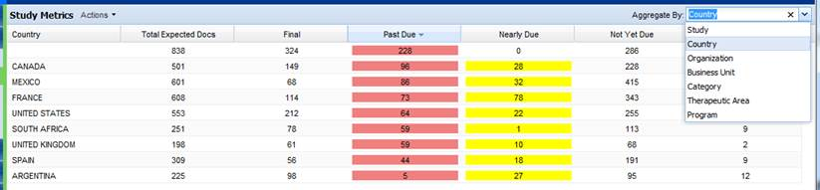
Example Report: TMF Completeness by Country
This report represents a snapshot of the completeness of a single study at the current time decomposed by Country. It shows the number of final, overdue, coming due and not yet due documents for each country.
The same report could be generated by Organization, Business Unit, Category/Zone, Therapeutic Area, or Program.

Slide 30
Example Graphic: TMF Completeness by Status
This chart represents a snapshot of the completeness of a single study at the current time.

Slide 31
Example Graphic: TMF Completeness by Status
This chart represents average completeness for each milestone across a collection of studies at a given time, e.g., all oncology studies.

Slide 32
Example Graphic: Quality Defect Breakdown
This chart represents a collection of studies and quality defects found during a selected time period, e.g., Q4 2013.

Slide 33
Example Graphic: Received Documents by Zone
This chart represents the breakdown of documents by type for all studies.

Slide 34
Metrics Program Design

Slide 35
Design of a Metrics Program
Goal Selection
  Quality by design
Choosing metrics to support your goals
  Cost – benefit analysis
  Support for risk-based approaches

Slide 36
Quality by Design and TMF Metrics
Quality by Design (QbD): designing and developing processes to ensure that a product (TMF in this case) consistently attains a predefined quality at the end of the process.
When applied to eTMF, QbD involves identifying key parameters that affect quality and risk, and monitoring those parameters
… achievable only when a metrics program is in place
Notes:
This is a successor to the "quality by QC" (or "quality after design") approach that the companies have taken up until 1990s.[

Slide 37
Defining Key Goals
Goals supported by metrics may come out of QbD sessions, audit findings, or many other sources. Examples:
  Audit readiness
  Decreased processing time
  Improved capacity planning
Make sure metrics goals support and align with overall organizational goals
Notes:
Make sure you are not just responding to the issue of the week

Slide 38
Achievable Goals
Choose an achievable set of goals and determine which specific metrics best support them
Consider a phased approach, i.e. introducing metrics gradually
  Low hanging fruit could be targeted first
  Once baseline metrics are available and understood, introduce escalation and personal responsibility, objectives and penalties

Slide 39
Example of QbD applied to eTMF
An example of applying QbD to eTMF is documented in “The New Gold Standard: Pfizer's Quality by Design Approach to Trial Management”, Pharmaceutical Executive, April 2013
  Business Case
  Solution Overview
  Critical-To-Quality attributes

Slide 40
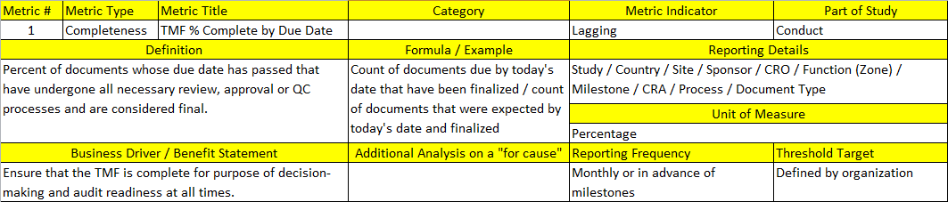
Cost vs. Benefit
How important is the business driver?
What would you have to invest to get this information?
Does the investment justify the benefit?
Notes:
Understand what you can get from your electronic systems, whether it has to be massaged, and what is entirely manual.

Slide 41

Quality: A Risk Based Approach
Ensuring quality is daunting… but what if you were managing a trial conducted in dozens of countries and over a thousand sites…
Defining a risk based approach
Is essential for success
Notes:
Need to keep in mind what is realistic given the number and size of your trials, relationships with partners, internal resources, etc.

Slide 42
Applying a Risk Based Approach
Identify which processes are more high risk. Examples:
  100% QC checks might be required for IP Greenlight documents, a lesser percentage for other processes or milestones
  Countries with more complex regulatory processes
  Sites with a high number of screening failures or protocol deviations
  Document types commonly examined by inspectors
  Content that affects patient safety
Take into account reliability of document source
  E.g. validated pharmacovigilance system vs. desktop scanning
Establish and monitor confidence levels
Notes:
May also need to identify documents key to a specific trial. For example, interim analysis documents might be key to an adaptive trial, or storage logs might be key to a trial for a drug that is very sensitive to environmental conditions and cold chain issues. If these documents were later found to be poorly scanned or unreadable, a serious issue would arise.
e.g., confidence levels of QC 50% of vendor documents, 5% of pharmacovigilance documents because the former come in from a variety of sources with their own SOPs, the latter from a validated system

Slide 43
Metrics Program Implementation

Slide 44
Metrics Program Implementation - Principal Considerations
Logistics (data population)
Accountability
Frequency
Presentation
Triggered activity & escalation
Notes:
When introducing a metric programme there are several key considerations that need defining for all metrics. Keep in mind that there may be more than one ‘answer’ for each point per report.
For example
E.g.. 1: if A TMF Completeness report looks at all Zones in the Ref Model; each department will be responsible for its functional docs.
E.g. 2: report frequency might not be the same for all users. Contracts Managers reviewing submission SLA may need a 6 monthly summary, whereas the study Manager may need to review the same information on a monthly basis.
Many of these factors will be defined in the Standard metrics structures as defined by the Metrics Champion Consortium - examples in Slides 19 & 20.
Also be realistic about the introduction of your metrics. This should be gradual and in partnership with key stakeholders (including data receivers and users).

Slide 45
Metrics Program Implementation - Logistics
Logistics
  For each metric; define how it will be populated and how it will be shared
  Consider the benefit of ‘self service reports’ vs circulation via email at scheduled frequencies
  For eTMFs, evaluate the use of pre-existing BI tools to supplement the eTMF toolset
  Remember to consider security and appropriateness of report vs audience
Notes:
For each metric, data sources need to be defined. For eTMFs this can involve pulling data from the eTMF directly or via an underlying database. (validation of data sources and population will be required – your ITQA department can advise you on what’s needed)
For paper data population will be more manual, and may involve summaries of trackers or even shelf space or folder counts. Although any data is better than no data, consider what tolerance you think is acceptable for each value collected and the % error that exists. Make sure this is communicated to receivers of the data where appropriate.
There are definitely pros and cons of both ‘self service reports’ and distributed reports. The former only works if the user 1) utilises the report 2) understands what they’re doing/reviewing. Therefore, the self-service approach although possibly more resource efficient and convenient, needs to be monitored to ensure it the results available are being utilised.
Manual circulation conversely would allow for highlights or concerns to be highlighted and could include a review/confirmation of receipt step to illustrate compliance.
Finally everyone likes using familiar systems so if you already use a BI tool or portal for scorecards, data analysis or reporting (e.g. Business Objects or Crystal Reports) – consider utilising the same technology for eTMF metrics as this will minimise the learning curve and probably increase uptake.
ON the final point careful consideration of audience is vital, particularly if the reports allow drill-through to data – ensure any reports that link directly to your eTMF system work with the security models already in place.

Slide 46
Metrics Program Implementation - Accountability
Accountability
  Remember the TMF includes documents from a multitude of functions; so a central, cross functional ‘Business Owner’ is advisable
  Consider generating a RACI (Responsible, Accountable, Consulted, Informed) to clarify who will be generating the metrics vs. who is accountable for their contents
Notes:
It is easy to consider Clinical Documents and forget about the rest of the TMF; ensure all doc-types are covered by your metrics (even if they are stored in different repositories or different formats).
A detailed RACI can be invaluable. Make this a living document and include distribution lists for those ‘informed’. That way all responsibilities are clear and recipients will have confidence in the report contents.

Slide 47
Example of eTMF RACI

Slide 48
Metrics Program Implementation - Frequency
Frequency
  Link frequency to the Business Benefit or Benefit Statement. What period of data and associated frequency is required?
  Do all users need the report at the same frequency and same view of data?
    Study Managers might need a monthly report
    CRO Account Manager may only need quarterly summary.
Notes:
If reports are self service, the frequency at which they should be reviewed and acted upon needs to be well communicated and if possible monitored.

Slide 49
Business Processes – Report Presentation
Presentation
  Most people find graphics easiest to interpret
  Consider different views for different time periods, e.g.
    6 month view cumulative graph of submissions
    Summary table of monthly detail
  Systems that allow drill through or data expansion offer most flexibility
  Use colour & formatting (e.g. traffic lights) to enhance tabular reports
  If using a portal consider:
    frequency of data archival
    benefit of keeping comparator data available e.g. 2013 data vs 2014
Notes:
If using a portal – first view should be the easiest to interpret for the majority of users
Saved or personal views will also be available with some tools
Obviously PowerPoint and (to a lesser extent) excel are useful for producing static reports, representing a specific view at a specific point in time.
These are more appropriate formats for published reports (distribute these on notice boards so TMF visibility/awareness becomes the expected norm)

Slide 50
Business Processes
Triggered activity & escalation
  You’ve distributed the metrics report – what next?
  How can you promote and measure compliance to reacting to the data?
    Define Workflow
    Define responsibilities in RACI
    Personal objective tie-in
    Management accountability
    ‘Metrics on metrics’
Notes:
Flow diagrams and workflows will compliment your metrics and help to provide clarity on expectations.
The metrics the working group have recommended fall into several categories, it is likely that escalation pathways and actions will be similar within each category.
Communication, documentation and training to support your metrics is key.
Continual support post-introduction to and gaining initial feedback is also vital. If people are confused by the data or do not know how to act on it appropriately the metrics become worthless.
Documentation should also include timelines for review and subsequent activity.

Slide 51
Business Processes – Role of Partners
Depending on Metrics introduced partners can be metrics providers or report receivers or both
Metrics can be linked to contracts and SLA and it’s advisable to create template reports and specific CRO generation/review responsibilities within contracts
Comparison between different CROs and CRO vs Sponsor users can aid future decision making and promote healthy competition
Notes:
MHRA often asks if sponsors have metrics to support and demonstrate oversight
Useful for multiple CROs working on a single study – can assist in determining where future work should be awarded

Slide 52
Metrics Program Implementation– Ongoing Program Review
Define timelines for review at point of introduction
Ensure the Business Drivers and/or Benefit Statements are valid and being met
Some metrics may become redundant as your eTMF model matures; circulating superfluous information is pointless
‘Quality’ is key – do not lose sight of this
Notes:
Are people acting on metrics and using to make decisions? If not either they are not useful or people don’t know how to apply them – adjustments needed in the program

Slide 53
Final Thoughts and Summary

Slide 54
Available Materials
This presentation
Metrics Definition spreadsheet covering metrics definitions, analyses, roles and glossary

Slide 55

Using Metrics to Drive Decision-Making and Behavior
“If a measurement matters at all, it is
because it must have some conceivable effect on decisions and behaviour. If we can't identify a decision that could be affected by a proposed measurement and how it could change those decisions, then the measurement simply has no value”
― Douglas W. Hubbard, How to Measure Anything: Finding the Value of "Intangibles" in Business

Slide 56
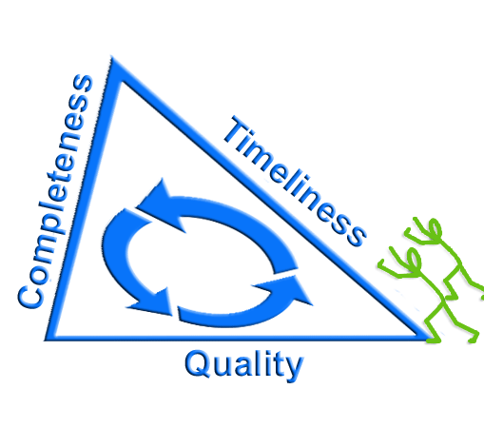
Opposing Forces in TMF Quality
Law of Unintended Consequences: actions always have effects that are unanticipated or unintended
Need to ensure that any effort to improve one of the key metrics doesn’t result in degradation in other areas
Notes:
For example: a focus on timeliness may result in decreased focus on quality that is only discovered later

Slide 57
Conclusions
Metrics are needed to provide the insight to manage risk and to implement true process improvements
Up-front investment in a well-designed metrics program can improve efficiency and increase compliance
Implement a program that
  Drives the behavior that you want
  Provides the information needed to make good decisions
Involve the business across your organization – don’t start with technology but understand what technology can do for you
Notes:
Instead of just reacting to issues and problems as they are found

Slide 58

Thank you
Chair of TMF Reference Model Metrics and Reporting Subteam:
  Kathie Clark, kclark@wingspan.com
Join the LinkedIn group TMF Metrics
The full set of materials can be found on the TMF Reference Model site: http://tmfrefmodel.com/resources-2/

