Slide 1
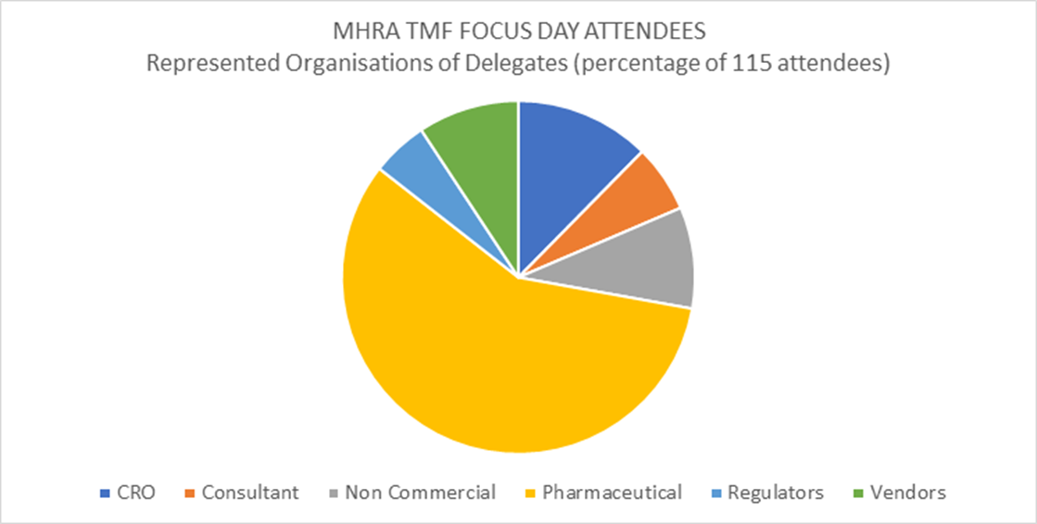
MHRA Workshop – 5th September 2017 (Karen Roy, Eldin Rammell, Jane Twitchen, Kathie Clark, Scott McCullogh, Fran Ross, Marie-Christine Poisson-Caraval, Dorte Frejwald Christianson)

Slide 2
Overview of the Day
Mock Inspection: Practical exercise to highlight the challenges
Regs and Ethics submissions and approvals in separate artifacts = a challenge
MHRA presentations on:
Assessing Compliance from Documents, Data and eSystems
The Inspector’s User Requirements for TMF
Sponsor, CRO and vendor presentations on:
Inspection Challenges and EMA Guidance Assessment (Vittoria and Mieke)
eTMF is a one-stop shop system
Direct Access
Demonstrating oversight
Draft document
Data migrations

Slide 3
Overview of the Day
Sponsor, CRO and vendor presentations on:
Fixing the Problems (Ivan and Lorrie)
Planning a QC programme
Management of email
Certified copies
Measuring a TMF
Inspection Readiness
Draft copies
Challenges when involving multiple organisations (Karen and Scott)
Multiple models
RACI and Oversight
TMF Source
Inspections
TMF Archive

Slide 4
Key Challenges / Points Raised by the MHRA
Bringing together EC / Regs submissions and approvals
Ensuring that the presented TMF structure is accurate to the specific TMF being inspected (but keep a standard company structure)
Identifying documents through naming conventions
Lack of sign-posts for document location esp. IMP documents
Lack of 3rd party vendors document and audit trail retention
Remote review – the MHRA do not yet have a procedure in place to facilitate this (although something they’re keen to do in the future)
Data Warehouses – the MHRA very keen to have access to these and any reports that give insight to study/system status

Slide 5
Key Questions Addressed
Data vs Documents
No issue maintaining in another system with guided access (and sign posts)
Could produce and file a summary report in the eTMF e.g. IRT
Multiple systems acceptable – e.g PV, eCRF, stats, eTMF
Audit trail management
Excel required to interrogate (v. large), PDF to prove no changes (but cant interrogate)
The sponsor should have an SOP or processes documenting how they use the Audit Trail (i.e. it’s not just a tool for the inspectors) – It is acceptable to review validated reports rather than audit trail directly
Challenge – balance vs effort, impact of patient safety, lack of alignment of MHRA to audit trail definition

Slide 6
Key Questions Addressed
Draft documents
There is no requirement for draft documents to be in the TMF, only final documents are required (unless a track changed draft was submitted to an Ethics Committee or Regulatory body)
There is a need to show evidence that the review process was followed for key documents such as the protocol
There is a need to show a summary of all comments raised for these key documents
Draft versions may be used to confirm that organisations were compliant to review process or a separate document to track the changes e.g. meeting minutes can be filed
Archiving and native format
Retain documents in native format as far as possible
It’s most important to be able to interrogate the data/have it in its original format
Mobile document capture
Acceptable if original stays at Site
Security access an issue to be addressed

Slide 7
Certified copies
2 clear messages – but require clarity
Certification NOT needed if original remains in ISF (Reg Binder) or sponsor TMF
i.e. certification only if copy is permanently REPLACING the original (original destroyed or otherwise not available)
Except: certification needed if eTMF presented to MHRA as the official TMF

Slide 8
SOURCE DOCUMENT | COPY PROCESS | WHAT HAPPENS TO COPY? | CERTIFY? | NOTES
Original at investigational site and maintained in ISF e.g. delegation log | Photocopy made at site and brought or emailed to sponsor | Photocopy filed in paper TMF | No | Original available for validation purposes if needed
Original at investigational site and maintained in ISF e.g. delegation log | Photocopy made at site and brought or emailed to sponsor | Photocopy scanned. PDF filed in eTMF | No | Original available for validation purposes if needed
Original at investigational site and maintained in ISF e.g. delegation log | Scanned copy uploaded via Sponsor eTMF portal | PDF filed in eTMF | No | Original available for validation purposes if needed
Copy at investigational site and maintained in ISF e.g. EC constitution (original at EC) | Photocopy made at site and brought or emailed to sponsor | Photocopy filed in paper TMF or scanned and saved to eTMF | No | No need to certify a copy of a copy
Microsoft Office document at site/CRO/vendor or deleted once transmitted to sponsor | Original sent by email as attachment to sponsor (though technically, it is actually a copy) | Original Microsoft Office document as received by sponsor filed in eTMF | No | Microsoft Office document considered to be the original

Slide 9
SOURCE DOCUMENT | COPY PROCESS | WHAT HAPPENS TO COPY? | CERTIFY? | NOTES
Microsoft Office document e.g. Word | Printed or saved to PDF using standard out-of-the-box “save as” functionality | PDF saved in eTMF | No (although could be ‘it depends’) | ‘Save to PDF’ and ‘Print to PDF’ is identical to ‘Print to printer’… which does not need certifying
Wet-ink paper original held by sponsor and maintained by sponsor | Scanned copy uploaded to TMF and checked against original | PDF filed in eTMF | Yes | Only if eTMF is primary TMF. Unclear Rationale for certification
Paper original held by sponsor and destroyed after eTMF upload e.g. SAP | Scanned copy uploaded to TMF and checked against original | PDF filed in eTMF | Yes | Scanned copy is replacing the original which is being destroyed
Paper original held by sponsor is archived after eTMF upload e.g. filenote | Scanned copy uploaded to TMF and checked against original | PDF filed in eTMF | Yes | Unclear Rationale for certification

Slide 10
MHRA Next Steps
Write up the event and publish on MHRA website
Review feedback and submitted questions to identify potential MHRA FAQ updates
Commence review of EMA consultation comments together with feedback received via this event (start this autumn with EMA IWG subgroup)
Meet with stakeholder groups for opinions concerning specific areas in the EMA guidance as required

Slide 11
QUESTIONS?
Join the TMF Reference Model
Yahoo! Group
http://tmfrefmodel.com/join
Knowledge sharing
Networking
Too Much Fun!

